Slide 1

CSE 470/598 Composition and Blending
Ross Maciejewski
rmacieje@asu.edu

Slide 2
Disclaimer
These slides can only be used as study material for the class 470 at ASU
The slides cannot be distributed or used for another purpose

Slide 3
Objectives
Learn to use the A component in RGBA color for
Blending for translucent surfaces
Compositing images
Antialiasing
First, the bad new … (it’s quite bad)
The Z buffer does not work as you might hope for transparent polygons
The Z buffer prevents OpenGL from drawing pixels that are behind things that have already been drawn
If materials are translucent, you want to draw things behind it

Slide 4

Opacity and Transparency
Opaque surfaces permit no light to pass through
Transparent surfaces permit all light to pass
Translucent surfaces pass some light
translucency = 1 – opacity (α)
opaque surface α =1

Slide 5
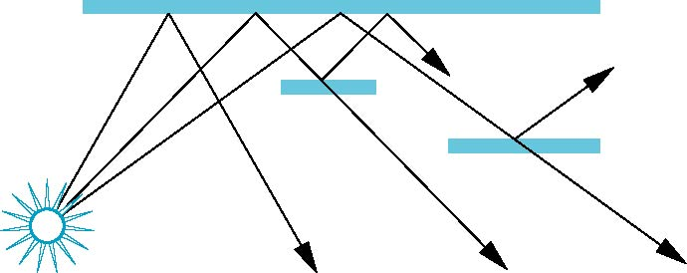
Physical Models
Dealing with translucency in a physically correct manner is difficult due to
the complexity of the internal interactions of light and matter
Using a pipeline renderer

Slide 6
Writing Model
Use A component of RGBA (or RGBα) color to store opacity
During rendering we can expand our writing model to use RGBA values
blend
source blending factor
source
component
destination
component
destination blending
factor
Color Buffer

Slide 7
Blending Equation
We can define source and destination blending factors for each RGBA component
s = [s_{r}, s_{g}, s_{b}, s_{α}]
d = [d_{r}, d_{g}, d_{b}, d_{α}]
Suppose that the source and destination colors are
b = [b_{r}, b_{g}, b_{b}, b_{α}]
c = [c_{r}, c_{g}, c_{b}, c_{α}]
Blend as
c’ = [b_{r} s_{r}+ c_{r} d_{r}, b_{g} s_{g}+ c_{g} d_{g} , b_{b} s_{b}+ c_{b} d_{b} , b_{α} s_{α}+ c_{α} d_{α} ]

Slide 8
OpenGL Blending and Compositing
Must enable blending and pick source and destination factors
glEnable(GL_BLEND)
glBlendFunc(source_factor,
destination_factor)
Only certain factors supported
GL_ZERO, GL_ONE
GL_SRC_ALPHA, GL_ONE_MINUS_SRC_ALPHA
GL_DST_ALPHA, GL_ONE_MINUS_DST_ALPHA
See Redbook for complete list

Slide 9
Example
Suppose that we start with the opaque background color (R₀,G₀,B₀,1)
This color becomes the initial destination color
We now want to blend in a translucent polygon with color (R₁,G₁,B₁,α₁)
Select GL_SRC_ALPHA and GL_ONE_MINUS_SRC_ALPHA as the source and destination blending factors
R’₁ = α₁ R₁ +(1- α₁) R_{0,} ……
Note this formula is correct if polygon is either opaque or transparent

Slide 10
Clamping and Accuracy
All the components (RGBA) are clamped and stay in the range (0,1)
However, in a typical system, RGBA values are only stored to 8 bits
Can easily loose accuracy if we add many components together
Example: add together n images
Divide all color components by n to avoid clamping
Blend with source factor = 1, destination factor = 1
But division by n loses bits

Slide 11
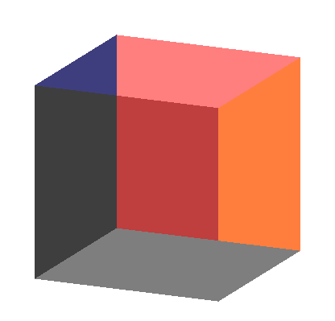
Order Dependency
Is this image correct?
Probably not
Polygons are rendered in the order they pass down the pipeline
Blending functions
are order dependent

Slide 12
Opaque and Translucent Polygons
Suppose that we have a group of polygons, some of which are opaque and some translucent
How do we use hidden-surface removal?
Opaque polygons block all polygons behind them and affect the depth buffer
Translucent polygons should not affect depth buffer
Render with glDepthMask(GL_FALSE) which makes depth buffer read-only
Sort polygons first to remove order dependency

Slide 13
Fog
We can composite with a fixed color and have the blending factors depend on depth
Simulates a fog effect
Blend source color C_{s} and fog color C_{f} by
C_{s}’=f C_{s} + (1-f) C_{f}
f is the fog factor
Exponential
Gaussian
Linear (depth cueing)

Slide 14
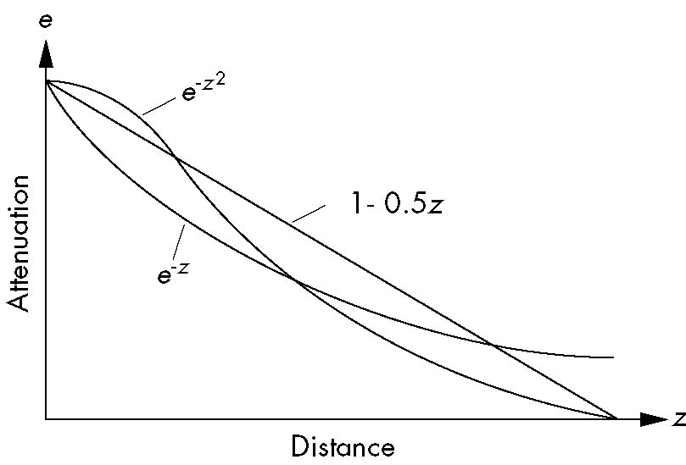
Fog Functions

Slide 15
OpenGL Fog Functions
GLfloat fcolor[4] = {……}:
glEnable(GL_FOG);
glFogf(GL_FOG_MODE, GL_EXP);
glFogf(GL_FOG_DENSITY, 0.5);
glFOgv(GL_FOG, fcolor);

Slide 16
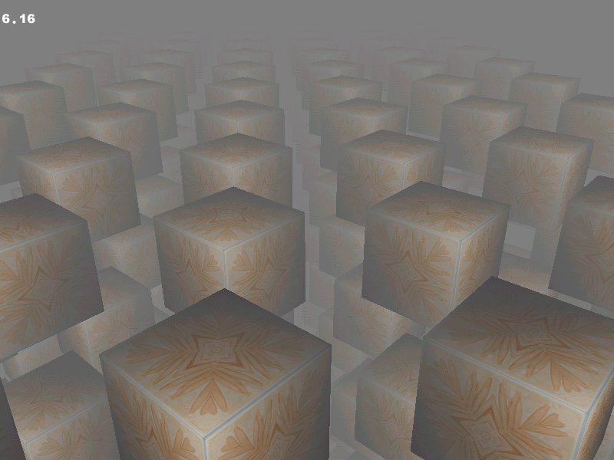
Fog Example

Slide 17
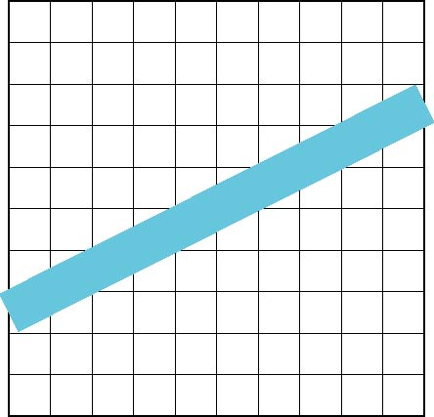
Line Aliasing
Ideal raster line is one pixel wide
All line segments, other than vertical and horizontal segments, partially cover pixels
Simple algorithms color only whole pixels
Lead to the “jaggies” or aliasing
Similar issue for polygons

Slide 18
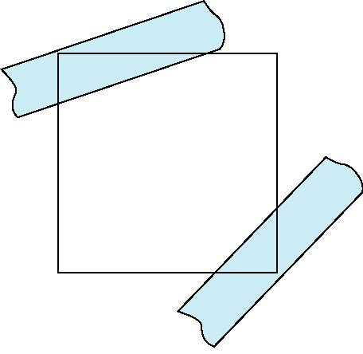
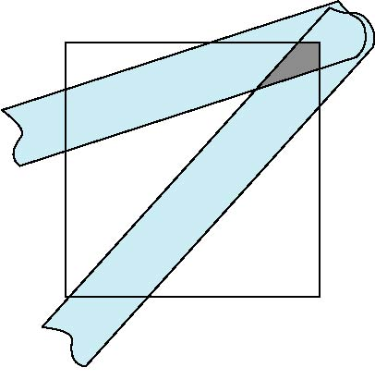
Antialiasing
Can try to color a pixel by adding a fraction of its color to the frame buffer
Fraction depends on percentage of pixel covered by fragment
Fraction depends on whether there is overlap
no overlap
overlap

Slide 19
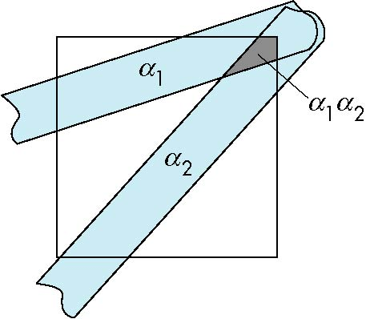
Area Averaging
Use average area α₁+α₂-α₁α₂ as blending factor

Slide 20
OpenGL Antialiasing
Can enable separately for points, lines, or polygons
glEnable(GL_POINT_SMOOTH);
glEnable(GL_LINE_SMOOTH);
glEnable(GL_POLYGON_SMOOTH);
glEnable(GL_BLEND);
glBlendFunc(GL_SRC_ALPHA, GL_ONE_MINUS_SRC_ALPHA);

Slide 21
Accumulation Buffer
Compositing and blending are limited by resolution of the frame buffer
Typically 8 bits per color component
The accumulation buffer is a high resolution buffer (16 or more bits per component) that avoids this problem
Write into it or read from it with a scale factor
Slower than direct compositing into the frame buffer

Slide 22
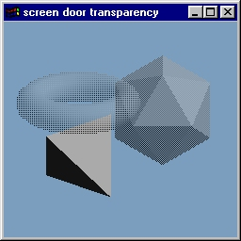
Screen-Door Transparency
Simple transparency technique
Uses a bit mask to cause certain pixels to not be rasterized
Percentage of bits in the bitmask which are set to 1 is equivalent to the transparency of the object
glPolygonStipple()
Defines a 32x32 polygon stipple pattern
glEnable(GL_POLYGON_STIPPLE)
Lookup into stipple pattern is done off screen
Different pattern should be used for objects which overlap
Advantage is objects do not need to be sorted

Slide 23
How to Render Glass?
Well … that’s hard because “glass” has lots of properties
General Algorithm for glass:
Render all opaque objects in your scene
Disable lighting and enable blending
Render glass geometry with small alpha value
You may need to sort glass geometry so it renders back to front
Glass needs specular highlighting
Set ambient and diffuse material colors to black and specular material and light to whit
Enable lighting
Set glDepthFunc(GL_EQUL)
Render glass object a second time

Slide 24
Transparency in Textures
If you want blending to occur after texture has been applied
glEnable(GL_BLEND)
glBlendFunc(GL_ONE, GL_ONE)
You may want to use alpha values that result from the texture mapping as part of the blend function
GL_SRC_ALPHA, GL_ONE_MINUS_SRC_ALPHA
If you want blending to occur when texture is map (parts of texture map allow underlying colors to show through)
glTexEnv() and set texture environment mode to GL_BLEND

Slide 25
Alpha Test
Often, transparency is a binary decision
If I have enough transparency added up, it becomes opaque
Do I want to blend with an alpha of zero?
No, it is very expensive to do all the time
glEnable(ALPHA_TEST)
AlphaFunc(enum func, clampf ref)
Func is a symbolic constant indicating the alpha test function
Ref is a reference value [0,1]
Func can be NEVER, ALWAYS, LESS, LEQUAL, EQUAL, GEQUAL, GREATER, NOTEQUAL

Slide 26
Visible-Surface Detection
Identifying visible parts of a scene (also called hidden-surface elimination)
Type of algorithm depends on: complexity of scene, type of objects, available equipment, static or animated displays
Object-space methods
Objects compared to each other
Image space methods
Point by point at each pixel location
Often sorting and coherence used

Slide 27
Visible Surface Detection Methods
The following algorithms are examples for different classes of methods
back-face detection
depth buffer method
scan-line method
depth-sorting method
area-subdivision method
octree methods
ray-casting method

Slide 28
Back-Face Detection
surfaces (polygons) with a surface normal pointing away from the eye cannot be visible (back faces)
We need to eliminate them before visibility algorithm !
viewing direction
⇒
can be eliminated:

Slide 29
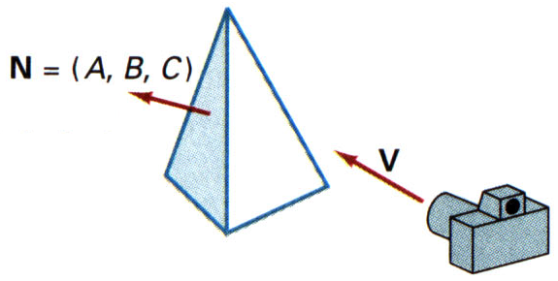
Back-Face Detection
eliminating back faces of closed polyhedra
view point (x,y,z) “inside” a polygon surface if
or polygon with normal N=(A,B,C) is a back face if
Ax
+
By
+
Cz
+
D
<
0
V_{view}

Slide 30
Back-Face Detection
Popular Implementation: Back face culling in window coordinates
Advantage: Does not need normal vectors
Idea1:Compute (only) the z coordinate of the normal vector
test if < 0 or > 0
Idea2: Compute the area of the triangle
test if < 0 or > 0
Idea1 and Idea2 should be computationally equivalent

Slide 31
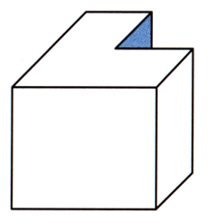
Back-Face Detection
BFC is complete visibility test for non-overlapping convex polyhedra
Not sufficient for concave polyhedra
Efficiency: BFC eliminates about 50% of surfaces
one face partially hidden by other faces

Slide 32
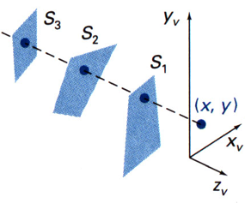
Depth-Buffer Method
z-buffer method
image-space method
hardware implementation
no sorting!
3 surfaces over-
lapping (x,y).
Visible surface S₁
has the smallest
depth value.

Slide 33
Depth-Buffer Method
Two buffers
Depth buffer (distance information)
Refresh buffer (intensity information)
size corresponds to screen resolution
(for every pixel: r, g, b, z)
draw something =
compare z with z in buffer
if z closer to viewer
then draw and update z in buffer
else nothing!

Slide 34
Depth-Buffer Algorithm Example
polygons with corresponding z-values
8
7
3
3
7
6
6
5
4
3
3
6
5
4
back-
ground
image
depth-
buffer
-infinity
8
7
8
7
3
3
7
6
3
6
7
6
3
3
3
3
3
6
5
4
3

Slide 35
Depth-Buffer Algorithm
for all (x,y)
depthBuff(x,y) =
frameBuff(x,y) = backgndColor
for each polygon P
for each position (x,y) on polygon P
calculate depth z
if z > depthBuff(x,y) then
depthBuff(x,y) = z
frameBuff(x,y) = surfColor(x,y)
− ∞
alternative

Slide 36
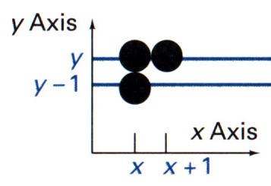
Depth-Buffer: Incremental z-Values
−Ax−By−D
z =
depth at (x,y):
depth at (x+1,y):
depth at (x,y-1):
C
−A(x+1)−By−D
A
z’ =
= z −
C
C
−Ax−B(y−1)−D
B
z” =
= z +
C
C
constants !

Slide 37
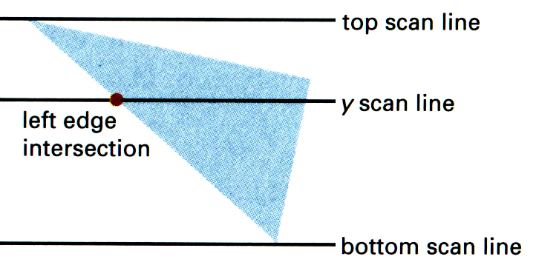
Depth-Buffer y-Coordinate Intervals
Determine y-coordinate extents of polygon P

Slide 38
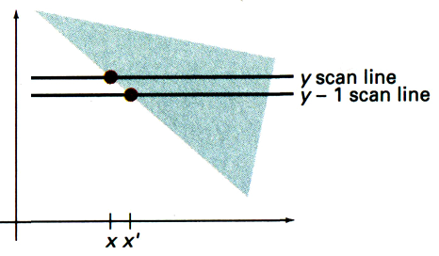
Depth-Buffer: Values down an Edge
−Ax−By−D
z =
C
x’ = x − 1/m
y’ = y − 1
−A(x−1/m)−B(y−1)−D
⇒
z’ =
C
A/m + B
= z +
C
constant !

Slide 39
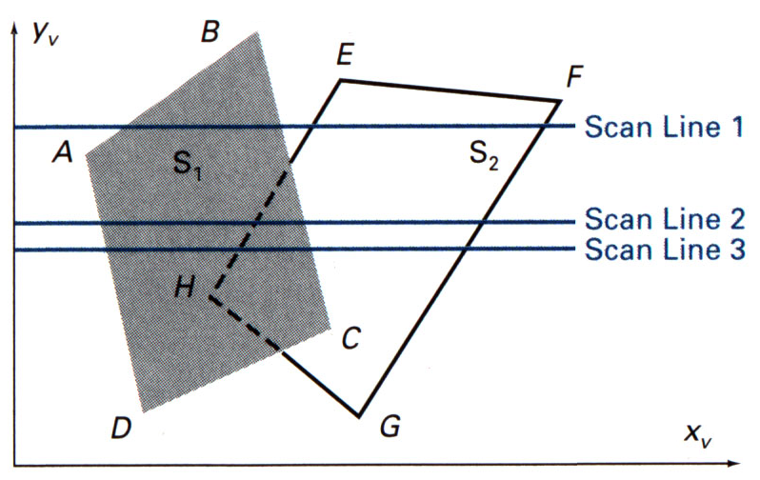
Scan-Line Method
Image-space method
Extension of scan-line algorithm for polygon filling

Slide 40
Scan-Line Method: Edge & Polygon Tables
Edge table (all edges, y-sorted)
Coordinate endpoints
Inverse slope
Pointers into polygon table
Polygon table (all polygons)
Coefficients of plane equation
Intensity information
(Pointers into edge table)

Slide 41
Scan-Line Method: Active Edge List
Active edge list (all edges crossing current scanline, x-sorted, flag)

Slide 42
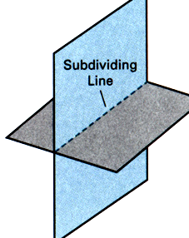
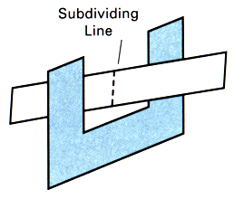
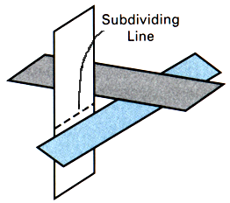
Scan-Line Method Details
Coherence between adjacent scan lines
Incremental calculations
Active edge list very similar (easy sorting, avoid depth calculations)
intersecting or cyclically overlapping surfaces!

Slide 43
Depth-Sorting Method: Overview
Surfaces sorted in order of decreasing depth (viewing in -z-direction)
“Approximate”-sorting using smallest z-value (greatest depth)
Fine-tuning to get correct depth order
Surfaces scan converted in order
Sorting both in image and object space
Scan conversion in image space
Also called “painter’s algorithm”

Slide 44
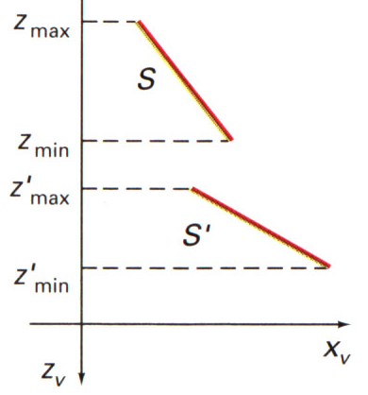
Depth-Sorting Method: Sorting
surface S with greatest depth compared to other surfaces S’
no depth overlap -> ordering correct
depth overlap -> do further tests in increasing order of complexity
2 surfaces with no depth overlap

Slide 45
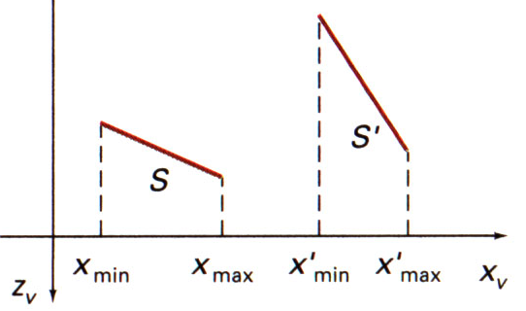
Depth-Sorting Method: Sorting
Ordering correct if
Bounding rectangles in xy-plane do not overlap
Check x-,y-direction separately
2 surfaces with depth overlap but no overlap in the x-direction

Slide 46
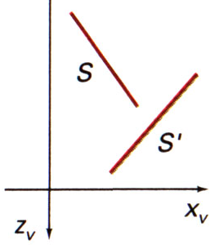
Depth-Sorting Method: Sorting
Ordering correct if
S completely behind S’
Substitute vertices of S into equation of S’
S is completely behind (“inside”) the overlapping S’

Slide 47
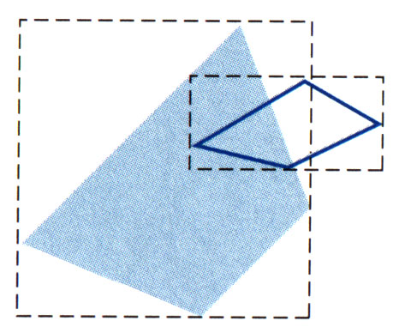
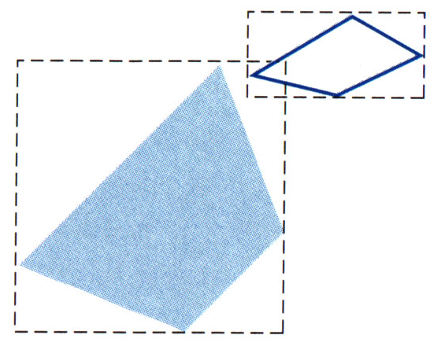
Depth-Sorting Method: Sorting
Ordering correct if
Projections of S,S’ in xy-plane don’t overlap
surfaces with overlapping bounding rectangles

Slide 48
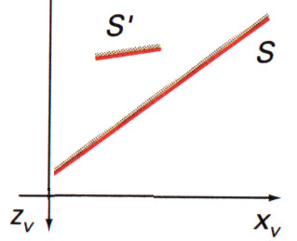
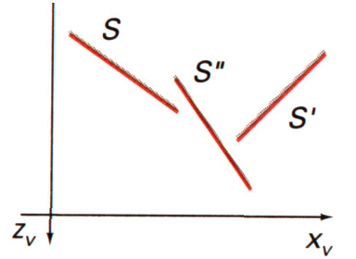
Depth-Sorting Method: Sorting
all four tests fail
ordering probably wrong
interchange surfaces S, S’
repeat process for reordered surfaces
surface S has greater depth but obscures S’
sorted surface list: S, S’, S” should be reordered: S’, S”, S

Slide 49
Depth-Sorting: Special Cases
Avoiding infinite loops due to cyclic overlap
Reordered surfaces S’ are flagged
If S’ would have to be reordered again -> divide S’ into two parts

Slide 50
Area-Subdivision Method
Image-space method
Area coherence exploited
Viewing area subdivided until visibility decision very easy

Slide 51
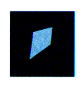
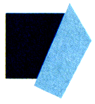
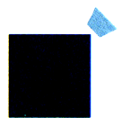
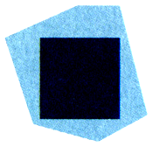
Area Subdivision Method
surrounding surface
overlapping surface
inside surface
outside surface

Slide 52
Area-Subdivision Method
Three easy visibility decisions
All surfaces are outside of viewing area
Checking bounding rectangles
Only one inside, overlapping, or surrounding surface is in the area
Bounding rectangles for initial check
One surrounding surface obscures all other surfaces within the viewing area
Minimum depth ordering

Slide 53
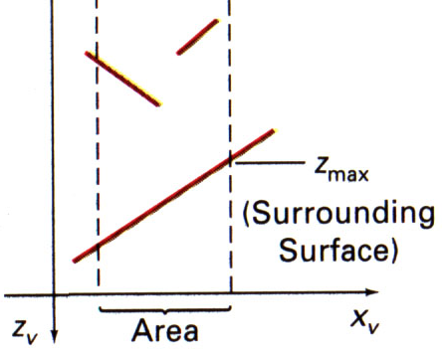
Area-Subdivision Method
A surrounding obscuring surface
Surface ordered according to minimum depth
Maximum depth of surrounding surface closest to view plane?
Test is conservative
viewing
direction

Slide 54
Area-Subdivision Method
If all three tests fail then do subdivision
Subdivide area into four equal subareas
Outside and surrounding surfaces will remain in this status for all subareas
Some inside and overlapping surfaces will be eliminated
No further subdivision possible (pixel resolution reached)
Sort surfaces and take intensity of nearest surface

Slide 55
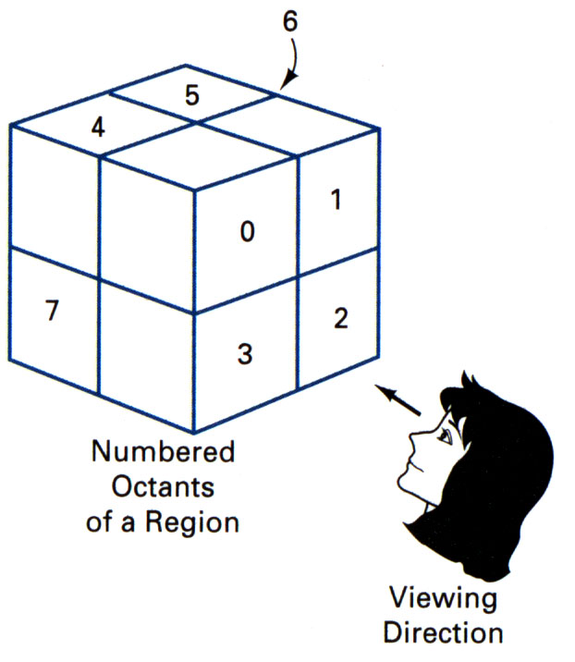
Octree Methods
Recursive traversal of octree
Traversal order depends on viewing direction
Front-to-back: pixel(x,y) written once
Completely obscured nodes are not traversed
Back-to-front:painter’s algorithm

Slide 56
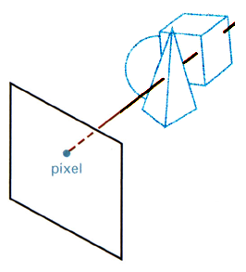
Ray-Casting Method
Line-of-sight of each pixel is intersected with all surfaces
Take closest intersected surface
scene
pixel

Slide 57
Ray-Casting Method
Based on geometric optics, tracing paths of light rays
Backward tracing of light rays
Suitable for complex, curved surfaces
Special case of ray-tracing algorithms
Efficient ray-surface intersection techniques necessary
Intersection point
Normal vector

Slide 58
Stencil Buffer
Similar to the depth and color buffer; however, stencil pixels have application specific meanings
Stencil buffer can be used for true 3D compositing in a two pass operation
First, the color buffer is disabled for writing
Stencil buffer is cleared, and the depth values are copied into the framebuffer
Depth testing is enable, insuring that only depth values that are closer to the camera can update the buffer
glStencilOp() is called to set a stencil buffer bit if the depth test passes

Slide 59
Stencil Buffer
The stencil buffer now contains a mask of pixels that were closer to the view than the pixels of the original image.
Color buffer is enabled for writing and color values are drawn to the frame buffer while the stencil buffer is now

